Slide 1
The Public Pensions Crisis
Ravitch Fiscal Reporting Program
Craig Newmark Graduate School of Journalism, CUNY
New York, NY
January 8, 2020
Don Boyd, Co-Director
State and Local Government Finance Project, Center for Policy Research
dboyd@albany.edu; slides at github.com/donboyd5/slides

Slide 2
Questions
What are defined benefit pension plans?
What’s the problem?
Why do we have a problem?
How big is the problem? Where are problems biggest?
What can state and local governments do?
What will happen next?

Slide 3
What are defined benefit pension plans?

Slide 4
What is a defined benefit?
The typical defined benefit pension is calculated as follows:
Step 1: # of years worked (called “years of service”)
x
Step 2: “benefit factor”
x
Step 3: a measure of pay (usually related to late-career salaries)
Example: Mary Smith retires after 20 years, 2% benefit factor, $60,000 final salary:
Pension = 20 years x 2% x $60,000 = 40% x $60,000 = $24,000 annually until death
Usually there are complexities: vesting rules, salary averaged over several years, alternative benefit calculations, survivorship benefits, COLAs, etc. But this is the essence of it. The benefit is defined, and required contributions will depend upon benefits and investment earnings. By contrast, if contributions are defined, benefits will depend upon contributions plus investment earnings. (There are hybrids, too.)

Slide 5
State & local defined benefit plans
14+ million workers, 6+ million retirees
> 6,000 plans; 170 large plans have 90% of assets
$4.6 trillion invested assets
$167 billion gov’t contributions annually
About 50% greater than roads/bridges capital spending
About 20+% of K-12 spending
About 8.5% of all taxes (was 4.6% in 2000)
Sources: Census, PPD, FRB, BEA. Details available on request.

Slide 6
Which governments do what?
Varied administrative arrangements:
State-run systems, state and local workers (e.g., CalPERS, NYSLERS)
City and county locally-run plans, local workers (NYCERS; Chicago; etc.)
State-run plans, multiple municipalities (Illinois IMRF)
Varied contribution arrangements:
State contributes for state workers in state-run system (common)
State contributes for local gov’t workers in state-run system (NJ)
Local gov’t contributes for local workers, state-run system (NYSLERS)
Local gov’t contributes for local workers, locally-run system (common)
Greatly varying benefit levels and legal protections for benefits

Slide 7
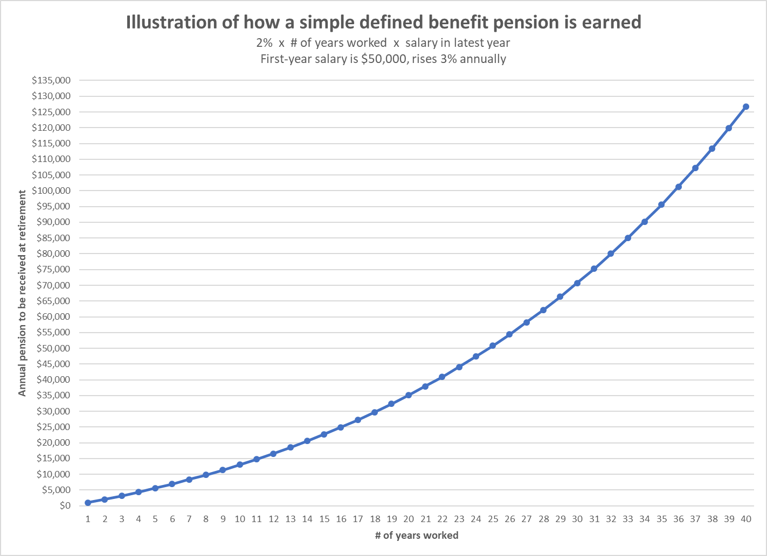
Benefits earned in a backloaded manner
Pensions increase significantly as careers lengthen – incentive to stay one more year.
Workers who leave early don’t get much.
If you cut the rate at which benefits will be earned for future service, it’s a big cut in expected pension for the current worker. (Think California Rule.)
If pensions were funded the way they are earned, contributions would have to rise as % of pay during worker’s career → Risky.

Slide 8
Why prefund pensions?
Current generation pays for services they receive.
Money is there to pay benefits when due. Legal protection vs. funding protection.
If strong legal protection, maybe workers and unions don’t need strong funding protection? Or does drastic underfunding create pressure to weaken legal protection?
Note: Some academics argue that full funding may not be the “right” policy. Dangerous, given real-world politics.

Slide 9
What’s the problem?

Slide 10
Usually governments, not workers, bear pension risk
If plan investments fall short, the government must increase contributions.
That means taxes must go up or spending on services, infrastructure, etc. must decline.
Many incentives encourage plans and governments to assume high investment returns and take investment risk. Other bad incentives, too.
The risks have not worked out well. Assumptions remain risky.

Slide 11
What is an unfunded liability?
The difference between:
Amount owed for benefits already earned* by current workers and retirees, and other past workers
and
Amount set aside for these benefits (assets)
* Policy implications?
Public plans measure these amounts differently than economists and the rest of the financial world.

Slide 12
Technical: What is an unfunded liability?
Actuary forecasts future benefit payments for current workers and retirees
Estimates present value of future benefits, using discount rate
Apportions present value: (a) amount already earned (Accrued Actuarial Liability, AAL), and (b) amount to be earned with future service.
Accrued Actuarial Liability minus “Actuarial Assets” equals
Unfunded Accrued Actuarial Liability (UAAL):
UAAL = Actuarial liability – Actuarial assets
What’s in this UAAL? What isn’t? Policy implications?
Notes: (1) more detail in appendix; (2) accounting terminology is different from actuarial terminology.

Slide 13
Why do we have a problem?

Slide 14
Bad incentives and no police
Attractive for 2- & 4-year elected officials to push costs to future. Institutional environment allows and encourages this.
Laws often are one-way streets: Governments can increase but rarely can reduce benefits. (Some exceptions.)
Unlike private plans, public plans not subject to ERISA and related federal laws; no federal funding requirements or minimum-contribution rules
Weak accounting standards compared to private. Unlike FASB:
GASB requires discount rate assumption based on plan’s own portfolio (incentive!)
No SEC oversight of accounting.
Governments effectively can veto appointments to the GASB board that oversees them.
Actuarial Standards Board guidance allows latitude and plans use it!
Congress has no role (so far) and is chary; Tower Amendment.
States can impose rules on local plans; hard to impose rules on themselves.
GASB = Governmental Accounting Standards Board; FASB = Financial Accounting Standards Board (for private sector accounting)
ERISA = Employee Retirement Income Security Act

Slide 15
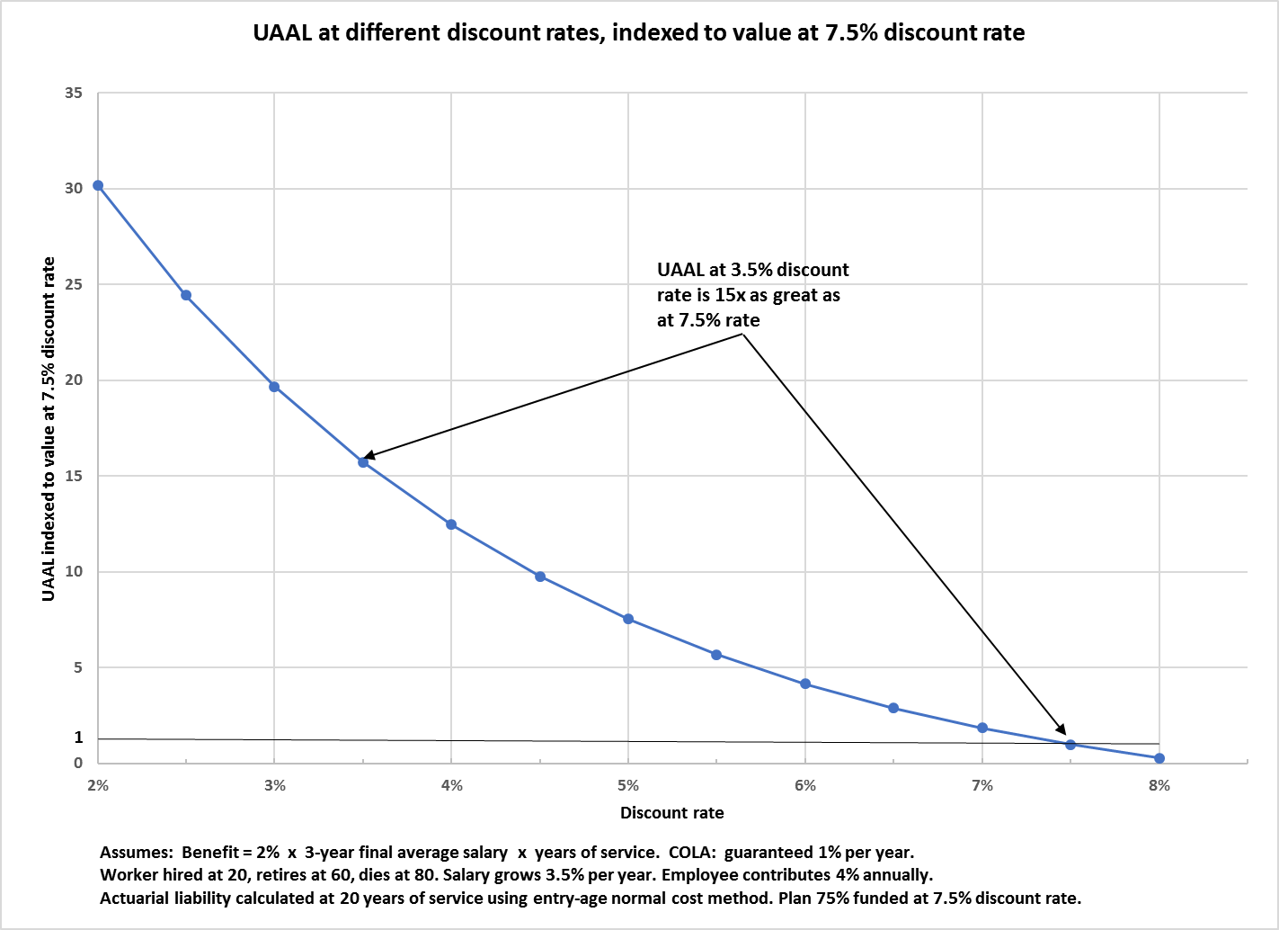
Higher discount rates → much better (reported) funded status

Slide 16
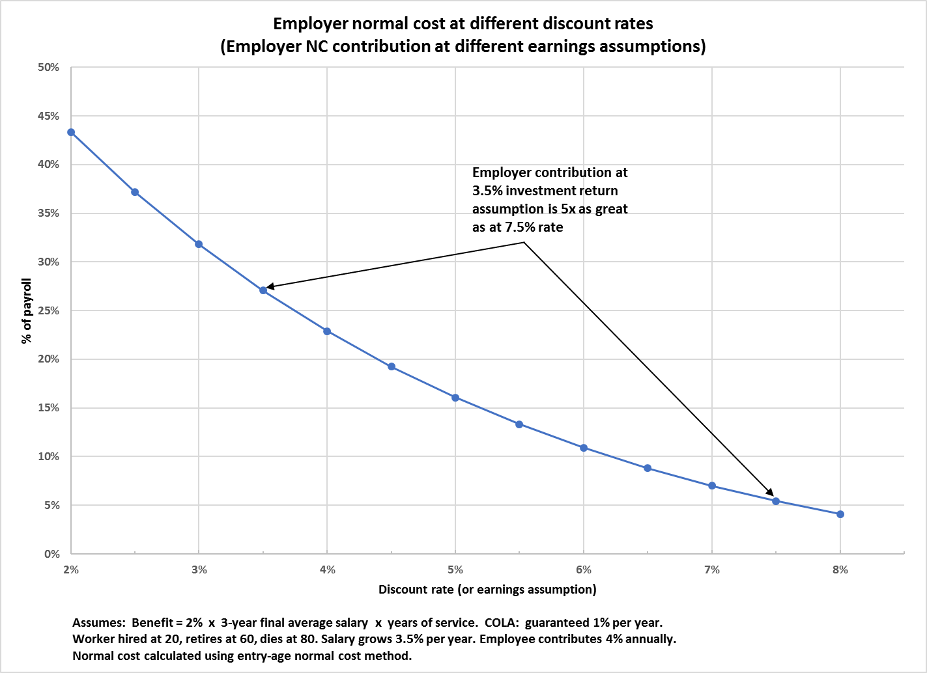
Higher assumed investment returns → much lower contributions

Slide 17
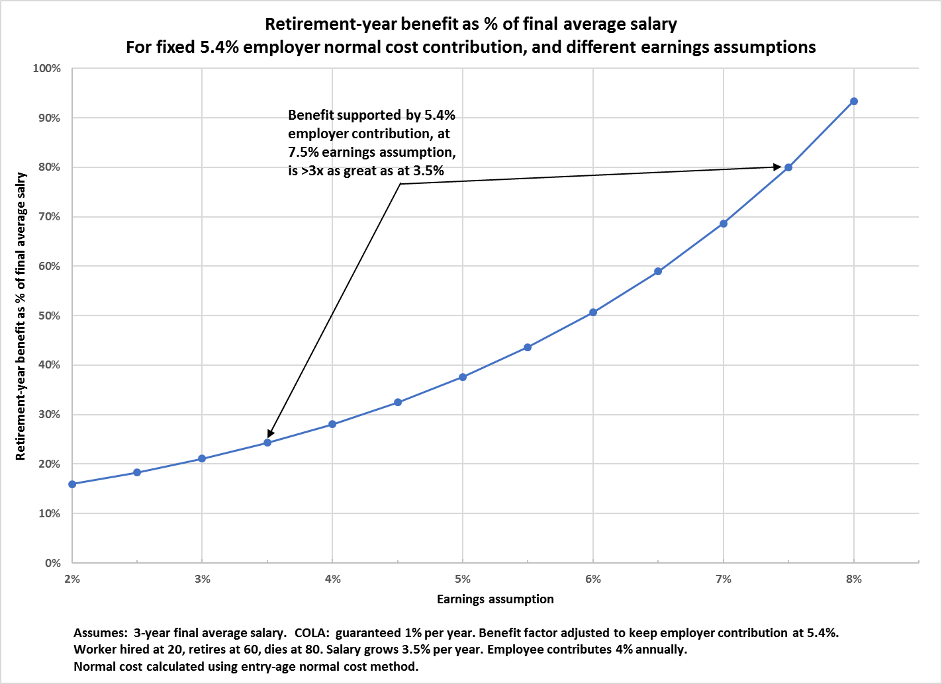
Also → Can offer higher benefits for a given contribution level

Slide 18
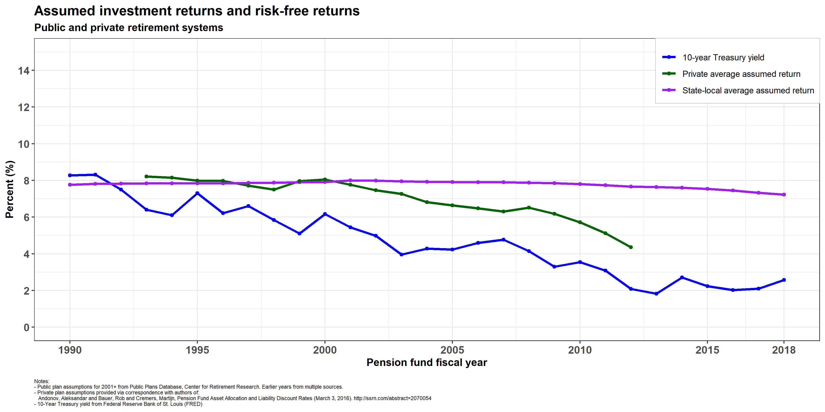
Public plans have lowered return assumptions only slightly in response to declining risk-free rates

Slide 19
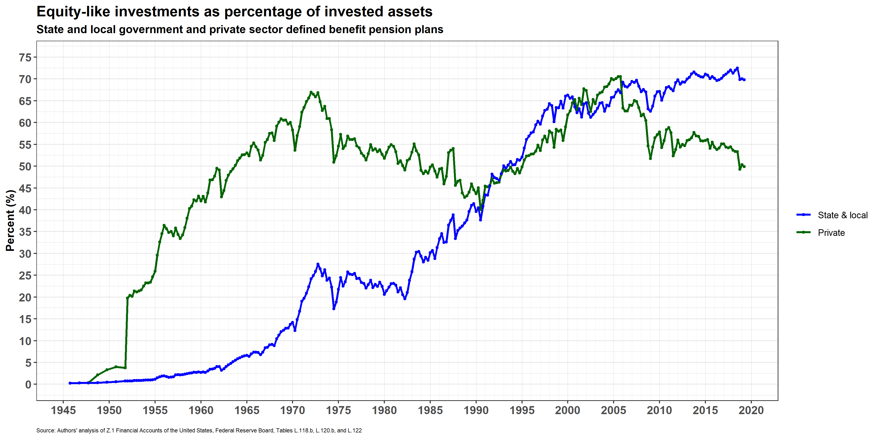
Public plans are increasingly invested in equity-like assets

Slide 20
Risk has increased relative to government budgets

Slide 21
U.S. public plans, with unique regulatory environment, have increased risk. Other plans have not.
Important paper: Andonov, Bauer, Cremers (2017). Examines, among other things, how U.S. public plans, private plans, and Canadian/European plans responded to Treasury rate declines.
Their statistical analysis shows that other plans reduced discount rates as market rates declined, but not U.S. public plans.
“U.S. public pension funds have become the biggest risk-takers among pension funds internationally”

Slide 22
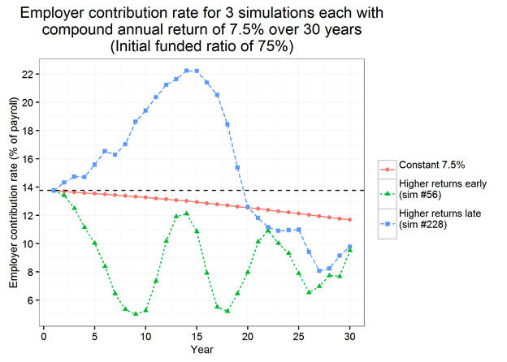
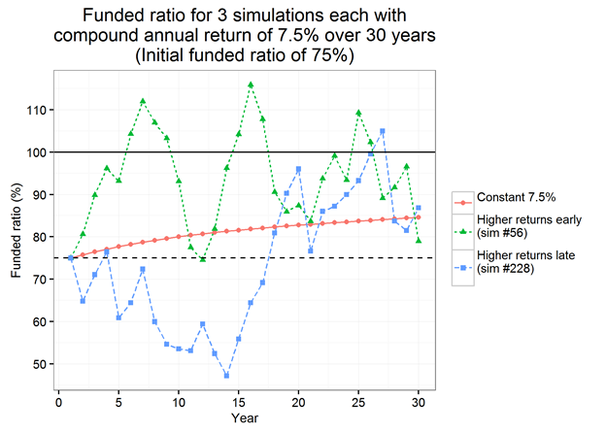
Even IF assumptions are correct, a roller coaster path
Three individual simulations, all with 7.5% discount rate & 30-year 7.5% compound annual returns.
Deterministic run: constant returns
Stochastic run: high returns in early years
Stochastic run: low returns in early years
People (politicians) interact with this system:
Will they support 50+% contribution increases?
Will they refrain from benefit increases and gimmicks if plan funding shoots above 100%?
And this is when return assumptions are met at 30 years. Most times, things will be better or worse than assumed.
Employer contribution rate
Funded ratio

Slide 23
How big is the problem?

Slide 24
Basic facts – underfunding
Controversy about how to measure liabilities
Per Federal Reserve Board 2019q3 unfunded liabilities were $4.3 trillion. By contrast public plan estimates are ~$1.5-2 trillion.
Great variation around country in extent of underfunding

Slide 25
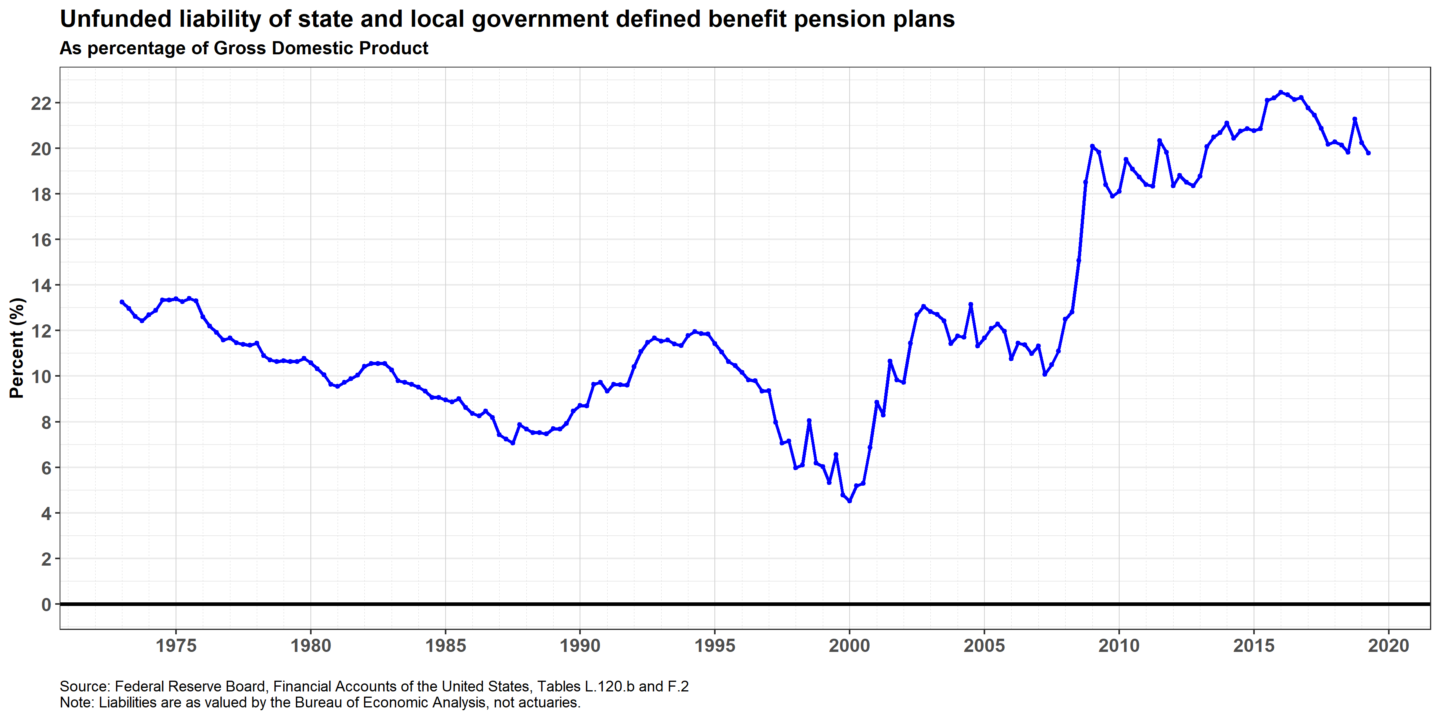
Despite contribution increases, unfunded liabilities are near record relative to economy

Slide 26
What does it take to tread water?
Tread water: Keep things from getting worse, i.e., keep unfunded liabilities from growing.
Requires contributions to cover costs of:
New benefits earned with a new year of service (the “normal cost”), plus
Interest on unfunded liability.

Slide 27
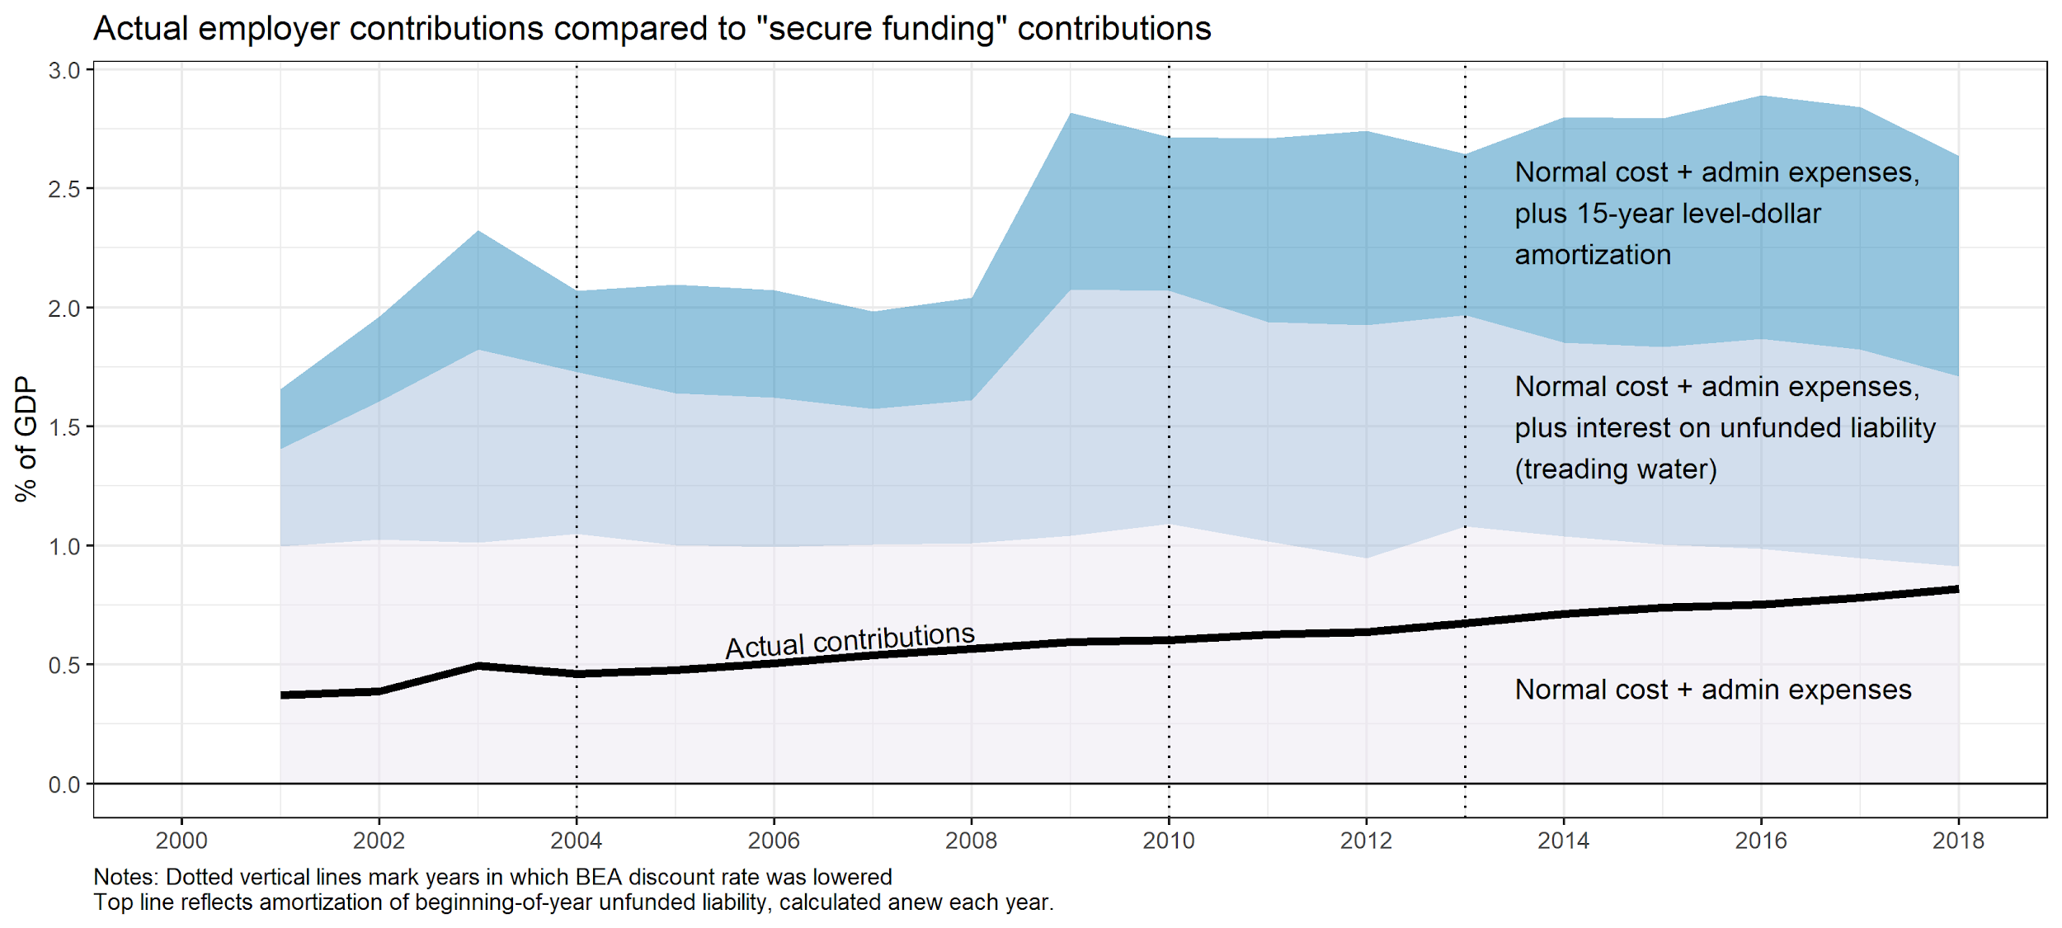
Huge gap between employer contributions and “secure funding”
Treadwater
gap – almost 1% of GDP

Slide 28
Where are problems the biggest?

Slide 29
Multiple overlapping underfunded plans must be funded by the same economic and tax base
For example, Illinois taxpayers (largely) must pay for multiple underfunded plans:
Illinois Teachers’ Retirement System
State Employees’ Retirement System
State Universities Retirement System
Chicago-area funds: Municipal Employees, Laborers’, Police, Firemen’s; Chicago Public Schools; Cook County Employees’; Chicago Transit Authority
Many lesser funds in the Chicago area and throughout the state, most of which are deeply underfunded
BEA data allow this. It is a valuable way to compare across states.
(It would be nice - but much harder still - to do this for smaller geographic areas.)

Slide 30
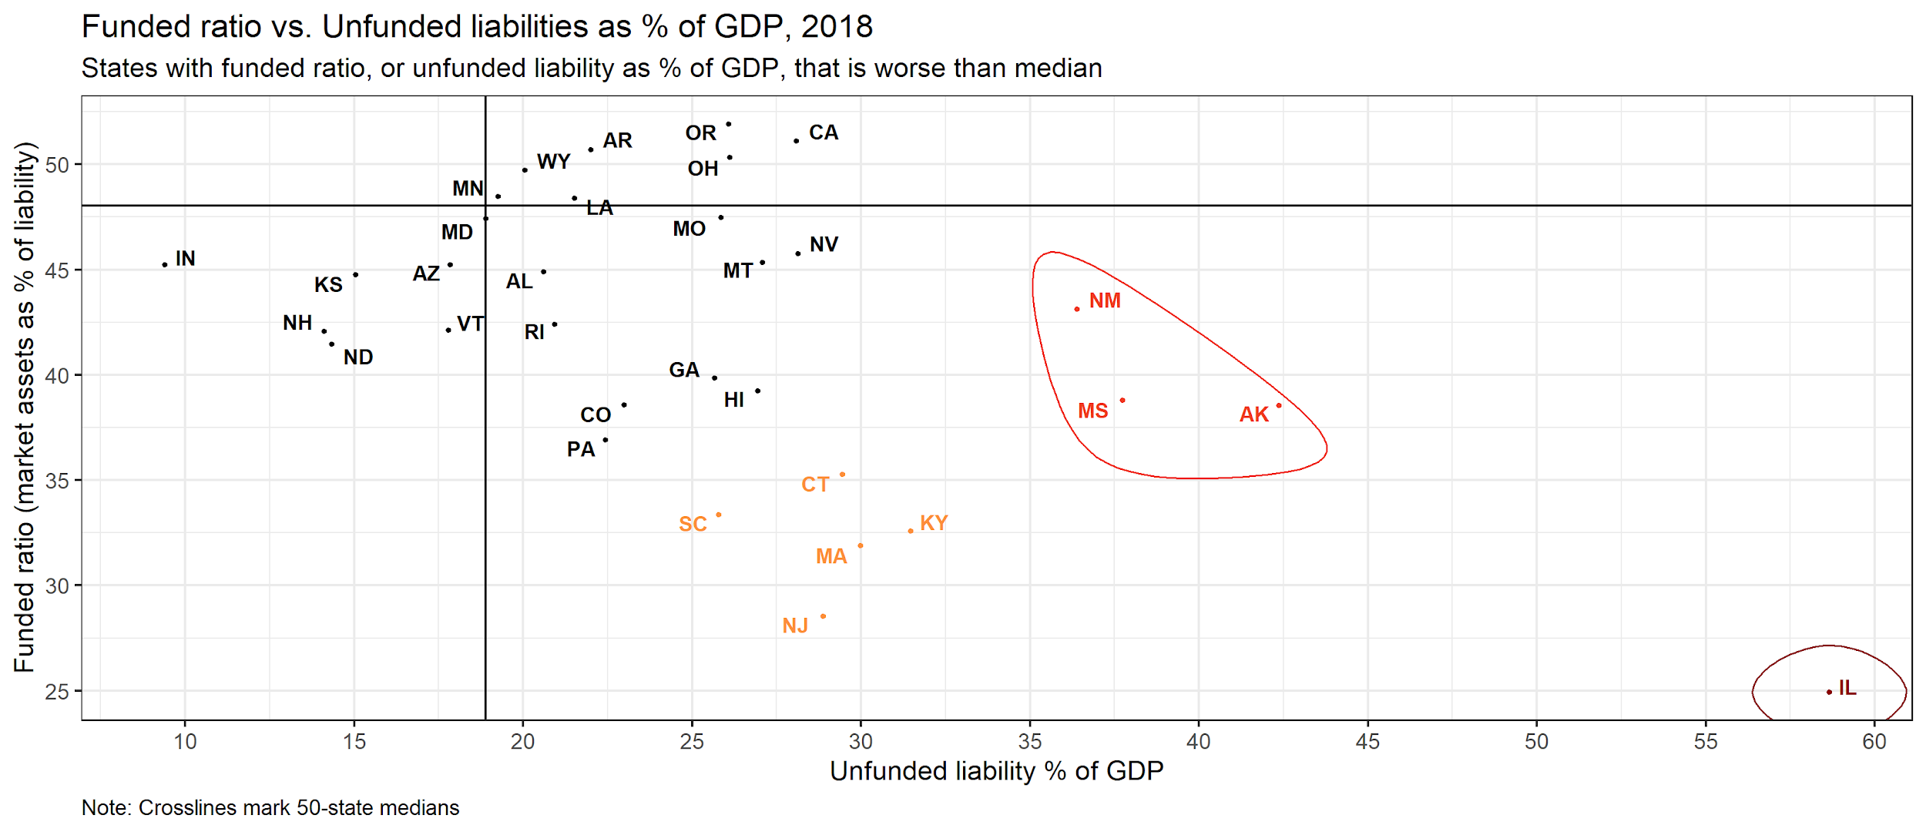
Comparing to the economy can be more revealing than simply looking at the funded ratio

Slide 31
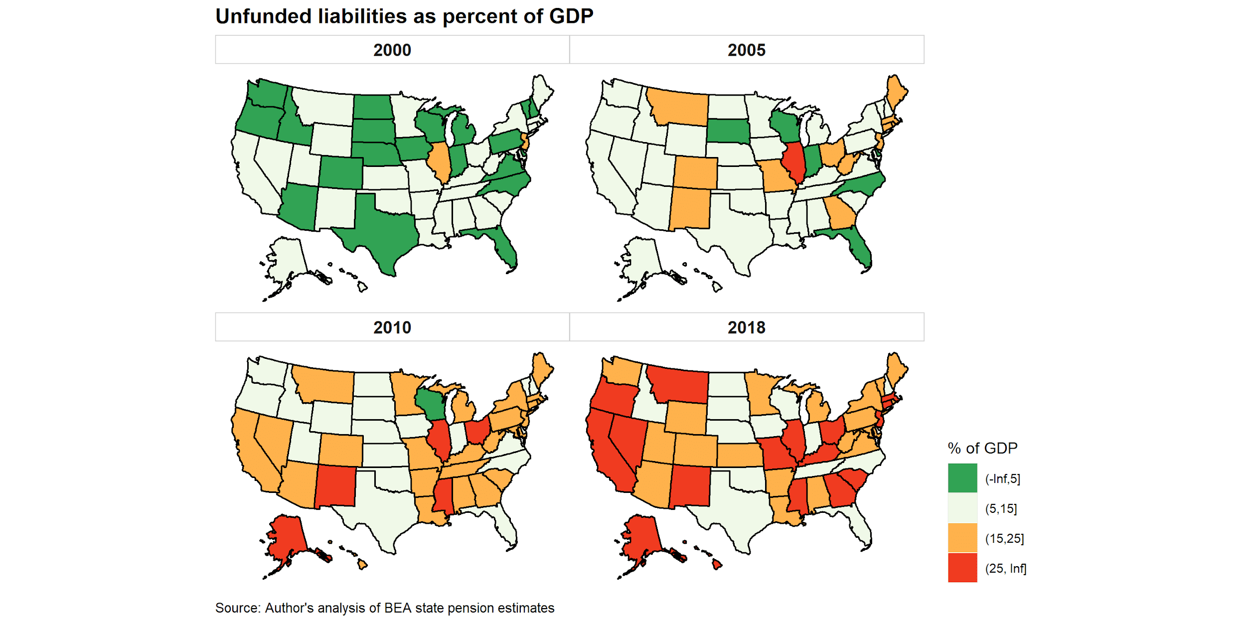
Unfunded liabilities have grown in most states

Slide 32
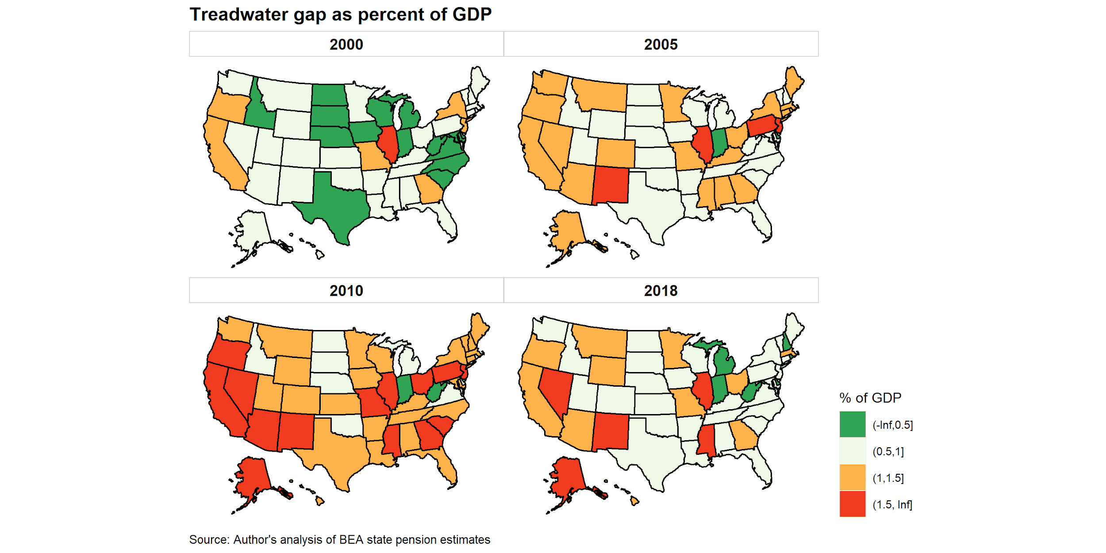
Contribution increase needed to “tread water” has fallen recently (due to contribution increases and benefit cuts)

Slide 33
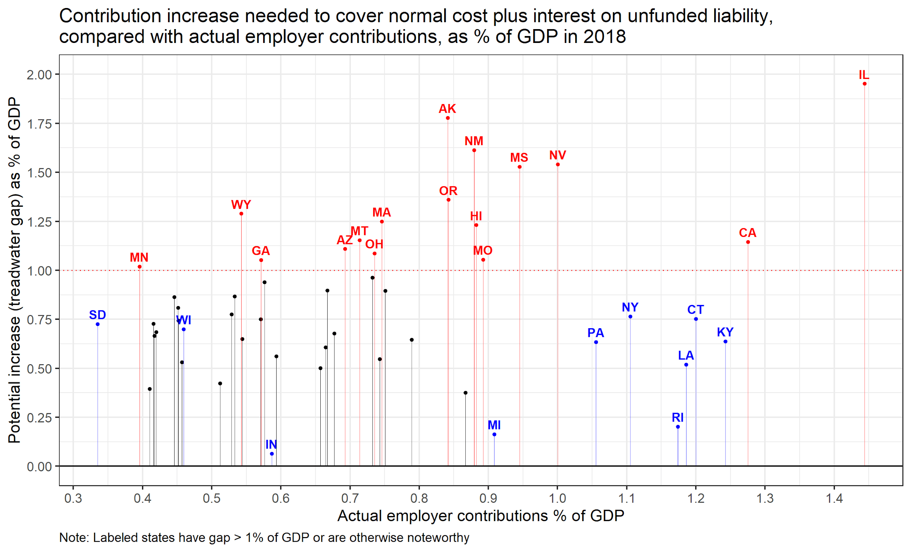
How hard would it be to tread water?
1% of GDP for US is roughly equivalent to:
49% of all state-local income or sales taxes, or
29% of all K12 spending, or
190% of all highway capital spending

Slide 34
What can state and local governments do?

Slide 35
Policy options highly constrained
Politicians understandably concerned about going back on commitments, especially to people who no longer work or are near retirement
Laws in some states are particularly constraining
Employee contribution increases often easier to do, legally than benefit cuts. Different impacts on plan members.
COLAs sometimes legally easier to do than other benefit changes.
“California rule” – an evolving issue – is especially constraining
Benefit cuts also can reduce a government’s attractiveness as an employer. Changes should be considered in this context.
Risk-sharing an option in some places: SD, WI; PA. Under consideration in some places.

Slide 36
Reducing unfunded liabilities – stylized view
People affected | What a government may be able to do* | Examples | Comments
1. People who don’t work for you yet | Anything | New tiers Hybrid DB-DC plans Risk-sharing | NONE OF THE UAAL IS HERE. A “stop digging” solution – can ease future costs, slowly. Competitiveness-as-employer issues. Most reforms have been here.
2. People who work for you now:
(a) Service they have yet to render | Depends. “California rule” may prevent cuts. In IL, state Supreme Court said cannot change. (Can lay off workers, but not change benefits) | Reduce benefit factor for future service Increase retirement age Change COLA | #3) SOME UAAL CAN BE IN HERE UNDER EAN COST METHOD BUT PROBABLY NOT MUCH. In some circumstances, can be substantial. Potentially important in distressed situations (e.g., Detroit). ERISA allows for private plans.
(b) Service they’ve already rendered | Hard to cut benefits, legally, politically, morally. | Haircuts, future benefits COLA cuts Contingent COLAs | #2) MOST REMAINING UAAL IS HERE. BIG IMPACT ON PROBLEM. Vested/non-vested distinctions matter, too.
3. People who used to work for you (e.g., retirees) | Hard to cut benefits, legally, politically, morally. Great variation. COLAs more susceptible to cuts than other benefits. | Haircuts, current benefits COLA cuts or suspension for retirees Contingent COLAs for retirees | #1) MOST OF THE UAAL IS HERE (Often 50-60%). BIG IMPACT ON PROBLEM.
* Varies greatly across states. See Monahan.

Slide 37
What will happen next?

Slide 38
Very difficult to predict
Investment risk is a wild card. Plans could get lucky, or even do much worse.
Benefits for new workers already reduced widely; some reductions in benefits for current members.
Laws in some states are particularly constraining
Employee contribution increases often easier to do, legally than benefit cuts. Different impacts on plan members.
COLAs often legally easier to do than other benefit changes.
“California rule” – an evolving issue – is especially constraining
Benefit cuts also can reduce a government’s attractiveness as an employer. Changes should be considered in this context.

Slide 39
What if a government has made promises it cannot keep?
Local governments
Bankruptcy is an option, if allowed by state.
All bets are off – bankruptcy is about breaking deals (and contracts).
Pain can be spread – to bondholders and to other creditors of the gov’t, not just to workers and retirees.
In fact, in general, pensions have been relatively protected. Will they be if bankruptcy becomes more widespread?
State governments
No bankruptcy option – see David Skeel…
No explicit mechanism to spread pain beyond workers and retirees.
Taxpayers, service beneficiaries, infrastructure-users still hit through political process – crowd-out. Probably not bondholders.

Slide 40
Conclusions

Slide 41
My conclusions
Liabilities and annual costs severely underestimated by plans.
ON AVERAGE, plans deeply underfunded.
Unless plans get lucky, investment returns won’t bail us out.
Benefit cuts for workers/retirees unlikely to be big part of solution.
Further tax increases and service cuts likely – “crowd out”.
Loss of political support for public defined benefits will encourage gradual movement to defined contribution plans and to risk-sharing DB plans.
And the system that allowed this will remain largely in place. The issue will be with us for many years.

Slide 42
Appendix

Slide 43
Selected compilations of public DB pension data
 | BEA | Public Plans Database (PPD) (Boston College...)* | Moody’s adjusted net pension liabilities*
Reported at: | State geography | Primarily plan-level | Primarily state-level totals for state plans, local plans
Universe | Complete -- estimated | ~190 plans ~90% of assets | 227 large SG plans; 50 large locals
Availability | Annual (CY), 2000-2018 | Annual (FY), 2001-2018 | Annual (FY), ~2011-2018
Discounting | Based on Moody’s AAA corporate; 4% for 2018 | Plan-chosen rates; 7.3% median for 2018 | High-quality long-term taxable (FTSE PLI); ~4.1% 2018
MV assets Liability Unfunded; FR Employer NC Payroll; NC % | $4.1 trillion $8.6 trillion $4.5 trillion; 47.3% $167 billion $928 b; ~17% (Boyd ests.) | $3.7 trillion $5.2 trillion $1.5 trillion; 71.8% $52 billion (noisy) $733 billion; 7.1% (noisy) | ~$1.6 tr states, $0.5 tr local
Other | Lumpy DR changes | Limited resources for QC | Paywall + inconvenient
* These are the most prominent producers/providers/publishers of these data. There are some alternatives.
Notes:
Notice the big difference in employer normal cost.

Slide 44
Elements of actuarial funding - stylized
Project future benefits for the current workforce (do nothing about people not yet hired). Imagine, for a specific worker, estimating years already worked, likely future years of service based on probability of leaving or dying, salary in each year, etc. Estimate pension at retirement and in each subsequent year until death. Scale it up.
Calculate the present value of that projected stream of future benefits (PVFB, or PVB) of all current workers, using a discount rate.
Split that present value into 3 pieces: already earned, being earned this year, still to be earned, using one of several possible “cost methods”
Benefits that we can attribute to years already worked – the accrued actuarial liability (AAL, or just AL)
Benefits that we can attribute to service in the year ahead – called normal cost (NC)
The remainder: benefits that we can attribute to future years of service after that – present value of future service
→ A common cost method is entry age normal (EAN), which calculates the normal cost as a constant percentage of pay.
Estimate under- or over-funding (UAAL) as “actuarial” assets minus the actuarial liability
Actuarial assets (AA) aren’t equal to the money you actually have! Usually they are smoothed over several years.
Actuarial liability (AL) minus actuarial assets (AA) equals unfunded accrued actuarial liability (UAAL) (or surplus).
→ Note that UAAL only includes liability attributed to years already worked (i.e., for current retirees, and for years already worked by existing workers). In theory, it includes nothing for years not yet worked by current workers and nothing for workers not yet hired. In theory, to reduce the UAAL, you need to reduce benefits already earned by retirees, or benefits already earned by current workers. Gulp. (There are some technical exceptions.)
Amortize (i.e., spread) any unfunded liability (UAAL), or overfunding, over future years.
Sometimes the amortization amount is called supplemental cost (SC)
Amortization can be quick, or slow, depending on many technical choices plans can make. Many studies have shown that amortization payments often are not great enough to reduce unfunded liabilities. A BIG problem.
Sum normal cost and amortization cost to get actuarially determined contribution (ADC), (formerly annual “required” contribution or ARC)
Employer’s actuarially determined contribution is total ADC minus the employee contribution (if any).
*NOTE: Governments often do not pay the full actuarially determined employer contribution. This is a BIG problem. It has been the proximate cause of virtually all MAJOR pension problems.

Slide 45
The discount rate controversy
Two separate but related concepts, often muddied:
Discount rate: used to value a future cash flow now (e.g., to determine the liability to report on financial statements).
Earnings assumption: what you think a specific investment portfolio will earn
Financial theory is unambiguous: What you owe has nothing to do with how you invest. Liabilities should be discounted using rates that reflect their characteristics, not a plan’s investment portfolio. Bond-like liabilities that must be paid should be discounted at approximately risk-free rates, for purposes of reporting liabilities.
But public pension plans use an earnings assumption to value liabilities. This practice assumes they will take investment risk successfully, before they have been successful (or not).
More investment risk → higher assumed return → lower contributions (now) → more money for everyone (except for future selves, kids, and grandkids). This is a BIG problem. $ trillions in play.
The choice of discount rate really matters. For example:
$100 benefit to be paid in 20 years is liability of:
$24 if discounted at 7.5% (typical plan assumption)
$61 if discounted at 2.5% (similar to risk-free rate)
Liability at 2.5% is nearly 3x as great as at 7.5%! Even bigger impacts on UAAL.
This is NOT a statement about how plans should invest. How much to invest in stocks and other risky assets is a separate decision.

Slide 46
Financial reporting vs. funding
Financial reporting – numbers that appear in the financial statements of governments and pension plans. Prepared by accountants, with input from actuaries. These statements report results for a year just ended. These numbers need not affect political behavior – e.g., the contributions a government makes. They are disclosure. Two main elements:
Liability – the amount owed for future benefits, to be reported on the balance sheet.
The cost of new benefits earned
Funding – by contrast, refers to how we determine how much money to set aside to pay for future pensions, taking into account how we will invest, and our tolerance for investment risk. Estimates prepared by actuaries, sometimes overridden by politicians.
Always, always, always must distinguish between financial reporting and funding. They are two separate activities.

Slide 47
Discount rate example

Slide 48
Additional risk: actuarial-valuation return assumptions seemingly inconsistent with capital market assumptions
Recent study: 28 large plans all used higher return assumptions for valuation and contributions than typical CMA justified; average discrepancy of 1.26% points.*
Some plans appear to justify this by stating that investment returns will fall short in the near term, but will be above the return assumption in later years:
CalPERS 6.2% over next decade, then 7.8%
Ohio PERS 6.76% next 5-7 years, then 7.85%
South Carolina plans are assuming returns of 4% over the next 4-6 years.
Our simulations of low-returns-early scenarios show that the risks of severe underfunding and large contribution increases in the early years rise substantially.**
* Christopher Mier, “Public Pensions: Complex Systems Still in Flux,” Municipal Finance Journal 38, no. 1 (Spring 2017). ** For example, see Yimeng Yin, and Donald J. Boyd. “Investment Return Volatility and the Pennsylvania Public School Employees’ Retirement System.” Nelson A. Rockefeller Institute of Government, August 2017.

Slide 49
Why it’s so hard to assess and compare pension fiscal stress
Plans report liabilities on assumption that they will be successful investors
Maybe yes, maybe no. With this kind of measurement, you tell us how the stock market will do, we’ll tell you magnitude of pension fiscal stress.
Another way: Report liabilities without assuming successful risk-taking. Disclose investment risk and potential consequences.
Actuarial contributions are far lower than they would be if plans did not assume successful investing
Actuarial contributions often stretch out repayments of unfunded liabilities over LONG periods
Some governments underpay actuarial contributions
Size of liabilities and payments relative to economy and budget are important – not just funded ratio.
Wide variation on these key characteristics

Slide 50
Legacy item | Is it a debt? | Important characteristics | Implications for solutions
Unfunded pension liabilities | Yes. It was promised, and creditors (workers) understand the promise. | A debt for services delivered in the past – thus, payment requires taxes but yields little political benefit. True payment needs generally not included in budgets, so proper repayment creates pressure. Strong legal protections, usually. Can be abrogated in bankruptcy. | Relatively weak public support for payment. The true legacy debt (as opposed to costs for new workers) usually will require bankruptcy-like arrangements to reduce debt.
Unfunded retiree health care obligations | Probably not, in general. Govts and workers/retirees often understand that plans, copays, benefits, and premiums may be changed. | An obligation for services delivered in the past; taxes with little political benefit. True payment needs rarely are included in budgets, so proper funding will be painful. Weak legal protections. May not need bankruptcy to abrogate. | Weak public support for payment, union opposition to changes. Can be changed in contract negotiations.
Bonded debt | Yes. Almost always well understood. | Yes. Payment needs usually are well-reflected in budgets, so repayment can be habitual. (Exceptions for some governments.) A debt for services still being delivered (kids use schools, and drivers drive on roads, built in the past but still “delivering” services). Strong legal protections; can be abrogated in bankruptcy. | Generally, requires bankruptcy-like arrangements to reduce debt.
Infrastructure deferred maintenance | No. | Maintenance can be easy to defer, especially in hard times. Failure to maintain has direct negative effects on the public. Relatively strong public support for infrastructure improvement. Don’t think bankruptcy should be relevant, generally. | One of the few issues for which voters tend to support tax increases.

